Slide 1
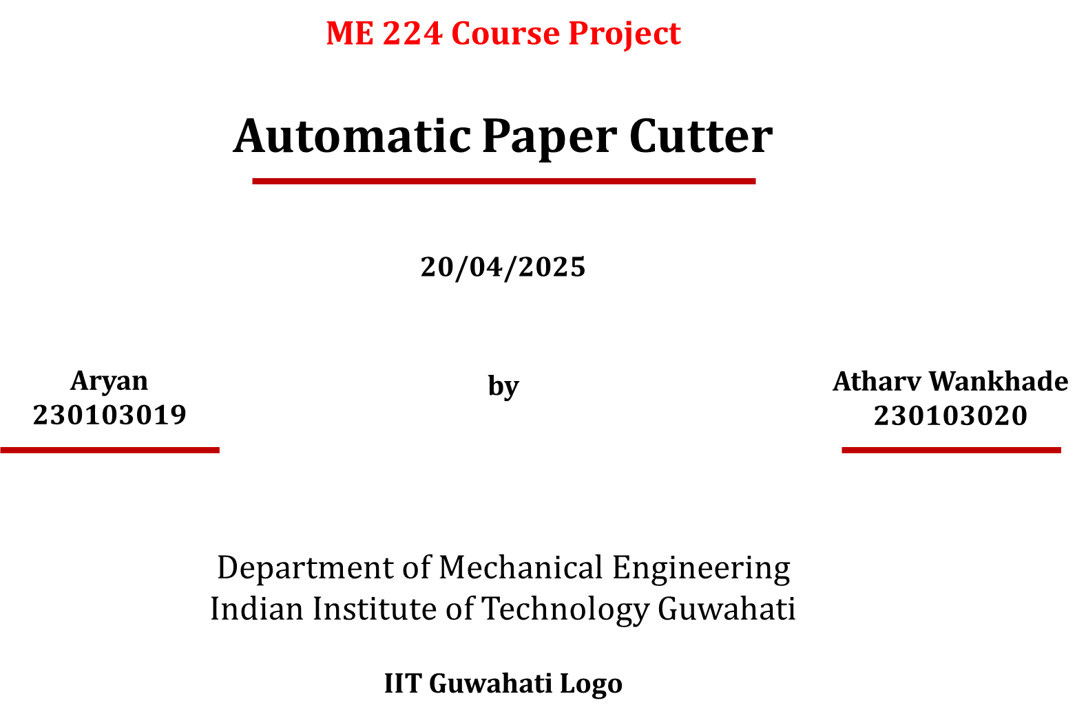





Slide 2
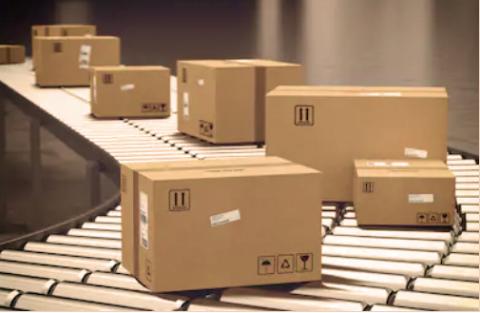
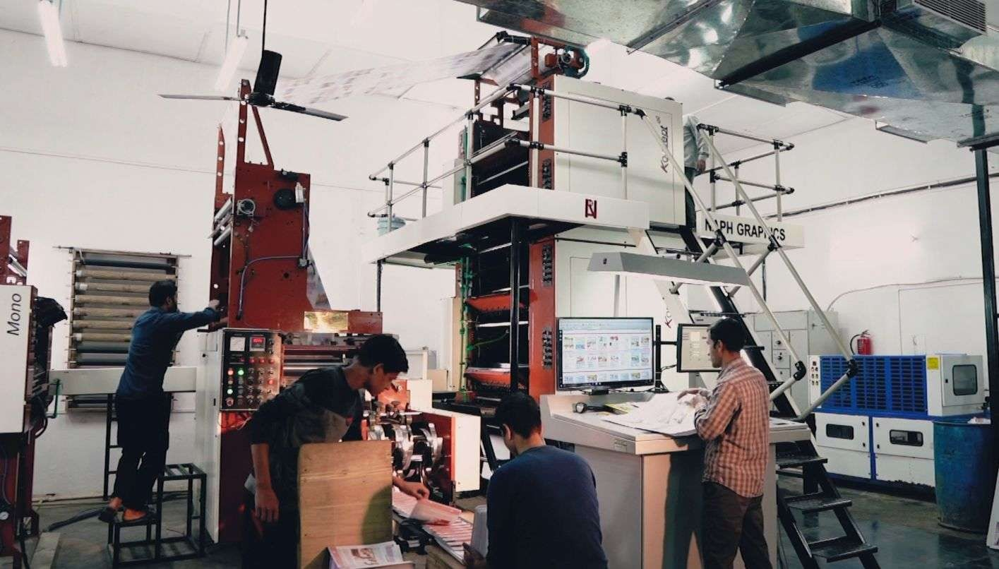
Motivation and Application
Manual paper cutting is time-consuming and inconsistent.
Automating the process increases productivity.
Also reduces human error and risk of injury.
Real World Applications:
Printing shops
Packaging Industries

Slide 3
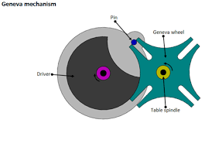
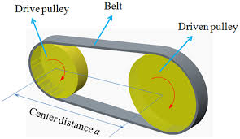
Originality beyond class assignments or teaching notes
Integrating the Geneva Mechanism for intermittent motion, ensuring precise and repeatable cuts.
Integrates belt-driven drive and motorized actuation.
Optimized for clean cuts on varied paper thicknesses.
Affordable for small bussinesses.

Slide 4
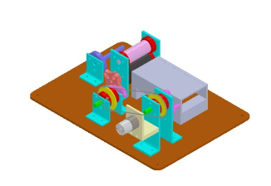
Kinematic Analysis
How does it move?
Intermittent motion via Geneva mechanism.
Single motor drives both the feeder and cutter using belts.
One rotation of the driving wheel advances the paper and cuts it once.

Slide 5
Kinematic Synthesis
Design Steps:
Dimensional Synthesis:
Optimized Geneva wheel teeth for smooth indexing.
Calculated crank radius for desired blade stroke.
Type Synthesis:
Hybrid system: Rotary motor + Geneva drive + linear slider.
Motion Planning:
Intermittent motion syncs with blade downforce.

Slide 6
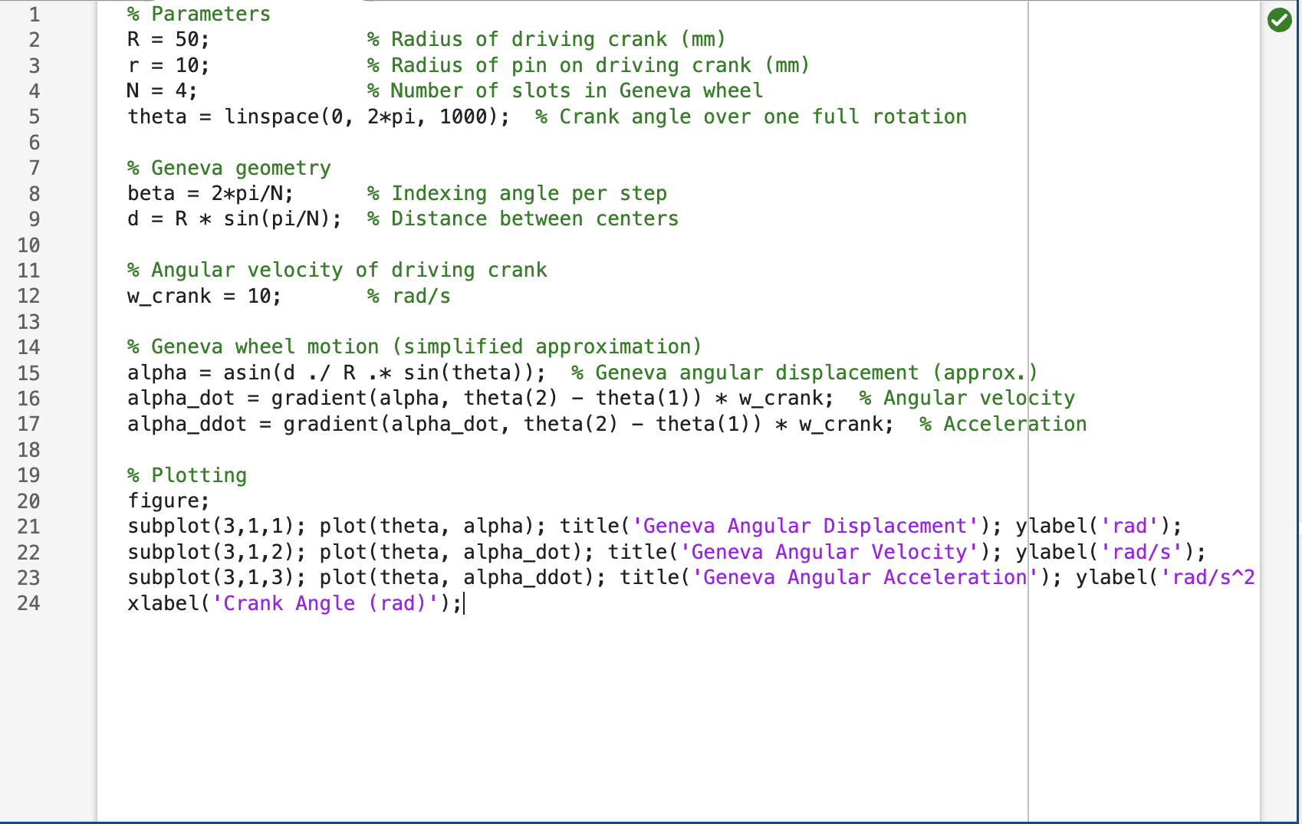

Slide 7
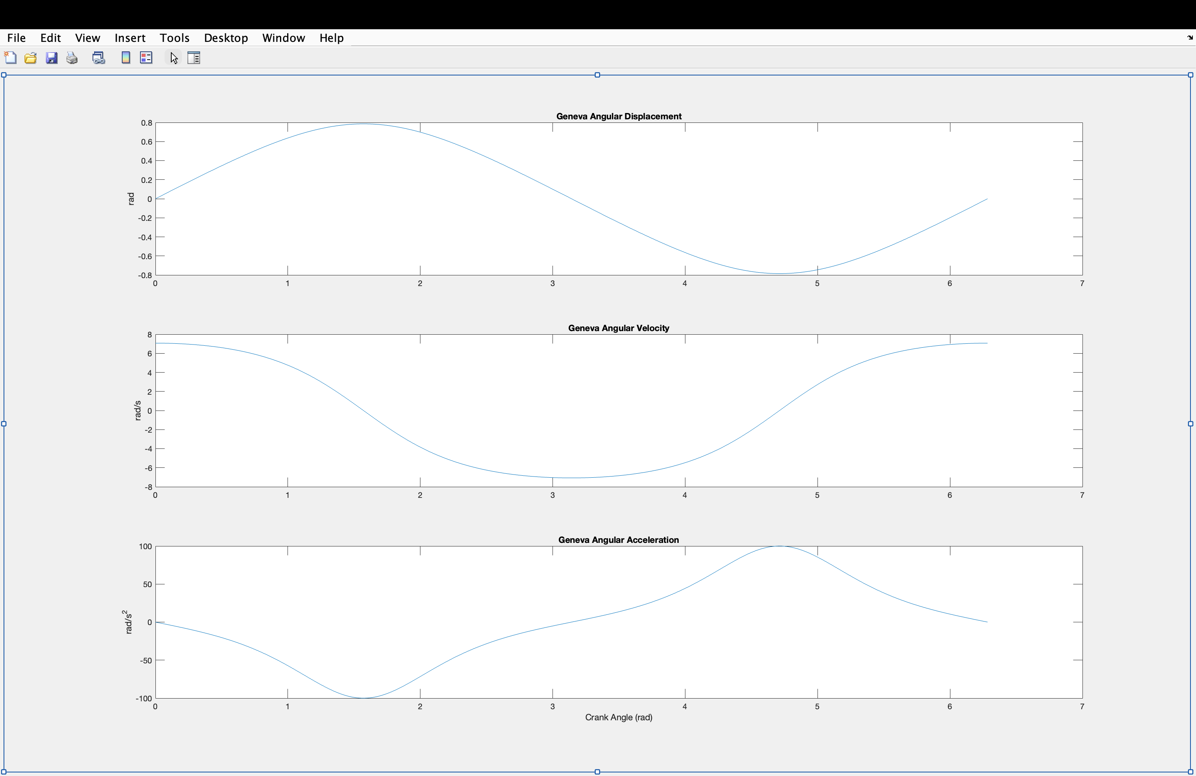

Slide 8
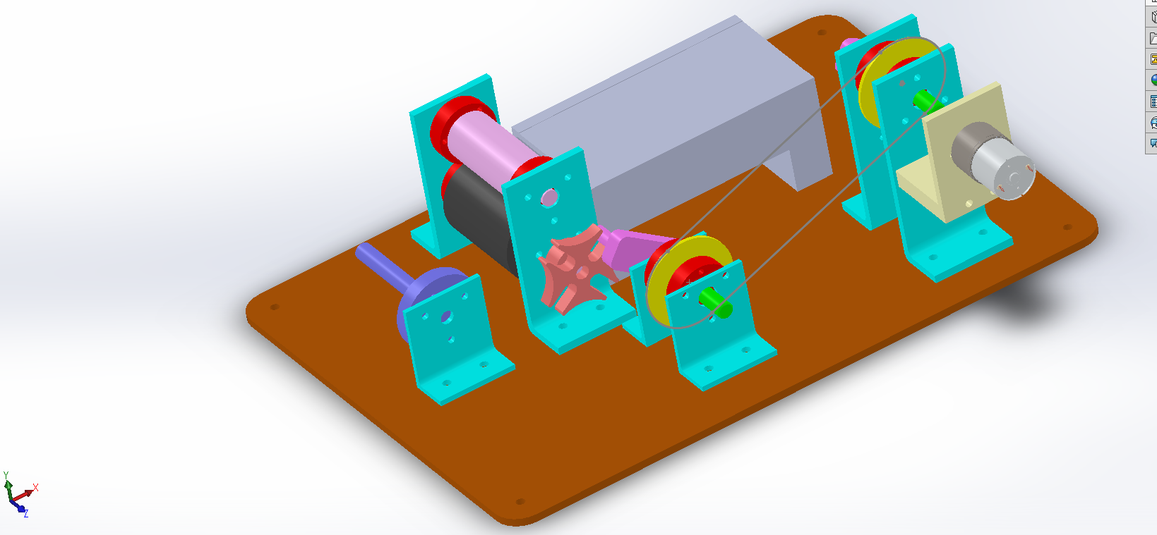
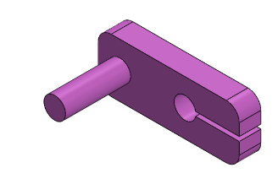
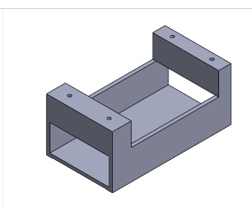
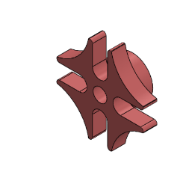
Computer Aided Design

Slide 9
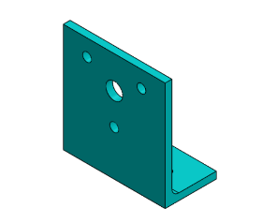
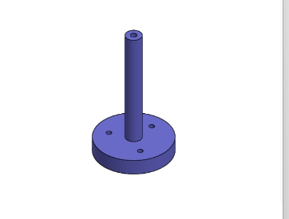

Slide 10
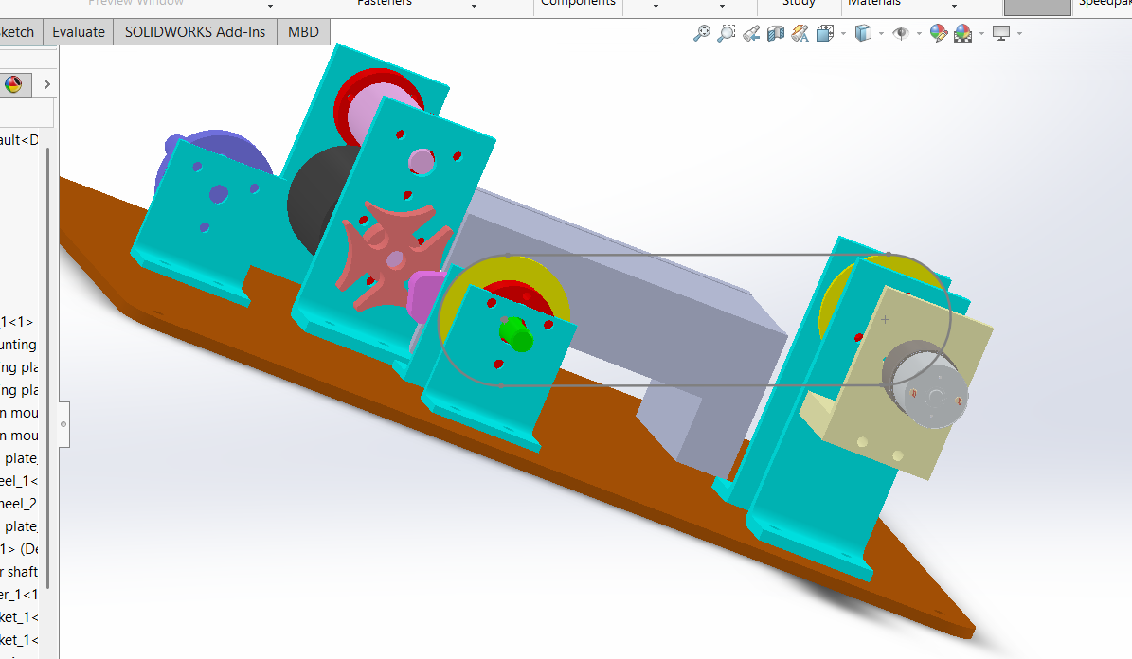

Slide 11
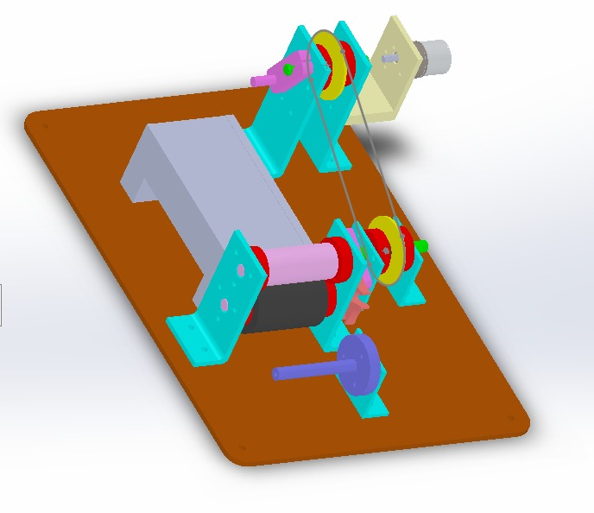

Slide 12
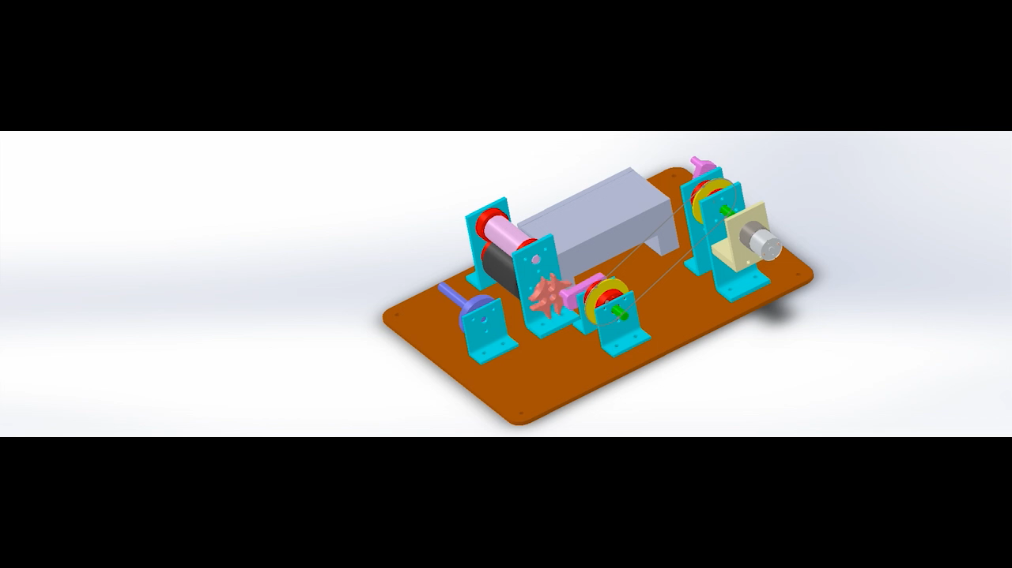
Motion Analysis / Study
Analyzed the angular velocity and acceleration of Geneva wheel and blade.
Ensured no jamming or excessive vibration during operation.
Timing of feed and cut is mechanically synchronized.
Analysis confirms consistent step rotation and motion transfer.

Slide 13
Fabrication Details
Materials Used:
Mild steel frame
High-carbon steel blade
3D-printed Geneva wheel (or acrylic).
Assembly steps:
Mount Geneva wheel and drive pin.
Align blade with paper feed.
Integrate motor and control circuit.

Slide 14
Conclusions
Provides an efficient, precise, and safe solution for automated paper cutting.
Reduces manual effort and improves consistency.
Scalable for various industrial and commercial applications.
Future Scope:
Auto-feed system for continuous cutting.
Pressure adjustment for thicker materials.
IoT integration for remote operation.

Slide 15
Thank You

